Slide 1
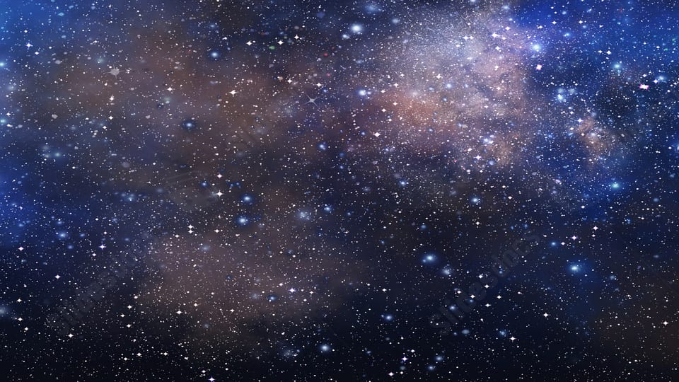
Habitable Exoplanets: Creating Worlds Beyond Our Own

Slide 2
What is habitual planet?
A habitable planet is a celestial body that is potentially capable of supporting life. The term is typically used to refer to planets that have liquid water on their surfaces, as liquid water is considered to be an essential ingredient for life as we know it.

Slide 3
Solar System of AAKUA
AAKUA s solar system has 4 planets.
AAKUA is at second place in the Solar System.

Slide 4
Stellar Type & Orbital Distance
Our planet is smaller than earth.
It will near to Red Dwarf Star.
As it is near to Red Dwarf Star so it is constantly bombarded with solar radiation coming from Red Dwarf Star.
Red Dwarf is smaller & cooler than sun, that’s why AAKUA is close to it’s star so it receives safe amount of sunlight as earth.
As it’s in it star’s habitable zone so the planet’s temperature is suitable for liquid water to exist.

Slide 5
AAKUA’s atmosphere
It has a strong magnetic field that protects the planet from harmful radiation. Without it the solar wind would erode the atmosphere, devoiding planet of the life giving air we can breathe there.
However the astronauts have to wear radiation resistant cloths to avoid getting in direct contact with ultraviolet radiation.
They have a alarm system to predict the timing when solar flare will hit the AAKUA. Usually they have 30-40 minute to find shelter before the solar flare reach the planet.

Slide 6
Planetary surface
AAKUA is a rocky planet that is slightly larger than Earth. It has earth like soil consist of silicon oxide.
It has 1.3 times gravity of the earth.

Slide 7
AAKUA’s gases
Nitrogen: 75%
Oxygen: 20%
Carbon dioxide: 0.03%
Water vapor: 1.5%
Argon: 1%
And other like helium, hydrogen

Slide 8
AAKUA’S SIMULATION CODE

Slide 9
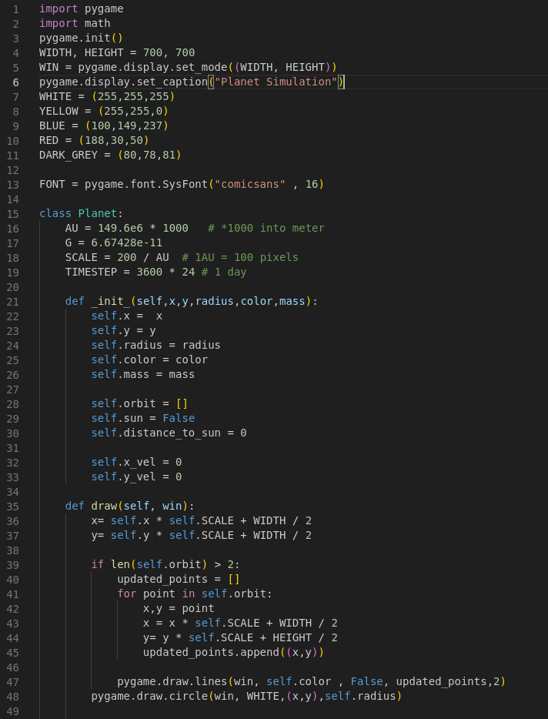

Slide 10
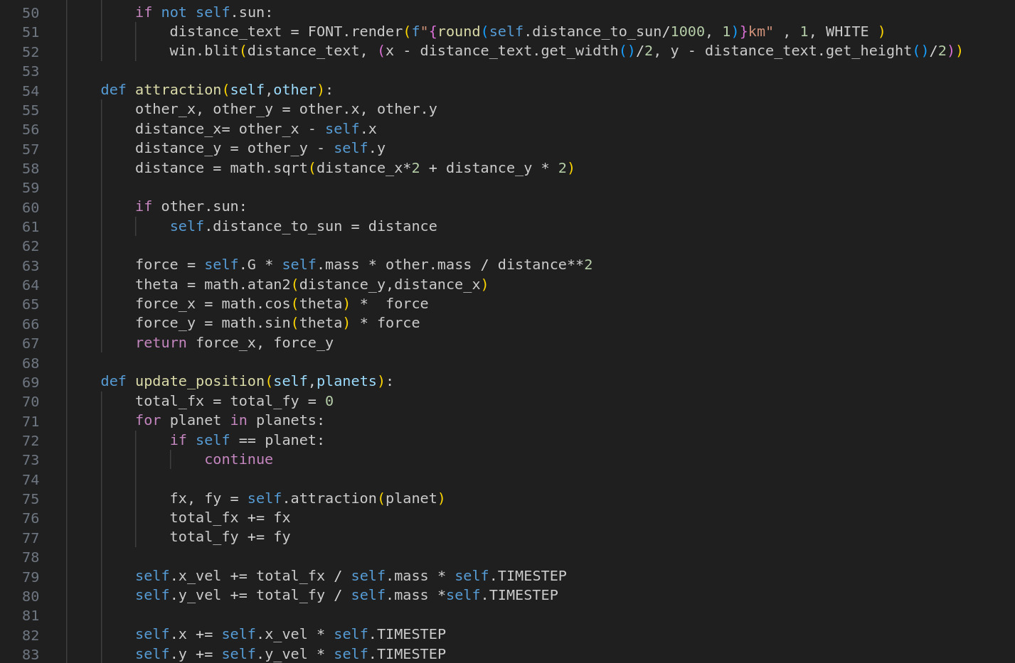

Slide 11
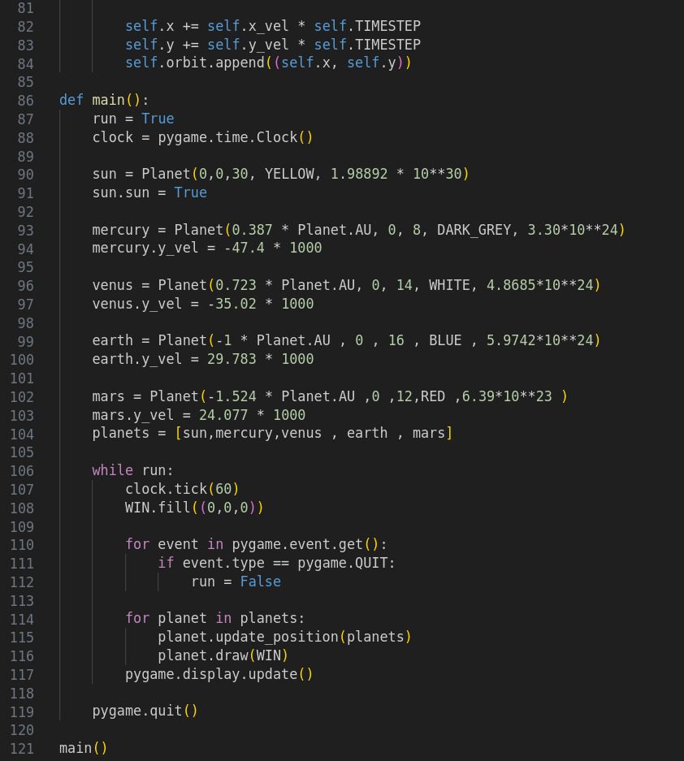

Slide 13
THANK YOU!!

